Slide 1
OS-Climate Sector-Alignment Tool (SAT)
AOA - Webinar
March 2023 Presenters: Leyla Javadova - Allianz Imke Horten - Allianz Michael Tiemann – Red Hat

Slide 2
Agenda
1 | Introduction – Leyla Javadova, Michael Tiemann | 4 | Live Demo – Michael Tiemann
2 | SAT Tool – Leyla Javadova | 5 | Feedback Questions - All
3 | Input Data – Imke Horten, Leyla Javadova

Slide 3
About OS-C Community

Slide 4


Open Source Context
OS-C is establishing an Open-Source collaboration community to build a data and software platform that will dramatically boost global capital flows into climate change mitigation and resilience. Through a non-profit, non-competitive organization, OS-C will aggregate the best available data, modelling, and computing and data science worldwide into an AI-enhanced physical-economic model that functions like an operating system, enabling powerful applications for climate integrated investing in a world where the future will be very different from the past.
Communities of Practice have long been a means to spark and nurture innovation
Communities of Practice typically cross organizational boundaries
Functions as a "coop" where the members of the community contribute software engineers, data scientists, project managers, and SMEs to build the solutions they need with other members
Sustained by benefits of participation, not formal command-and-control
Well-suited to missions larger than any one organization can manage
Open-Source software development well-suited to trans-organization collaboration
OS-Climate examples:
Transition Analysis and Opportunity
Sector Alignment and Portfolio Alignment tools
Physical Risk and Resilience
Sovereign Carbon Footprint Analysis (based on PCAF)
Data Commons and Data Exchange

Slide 5
We need your feedback:
What are the main use cases for you to apply a sector alignment tool?
Should the tool integrate combined scope 1 + 2 + 3 Emissions or separate these?
How comfortable are you with Scope 3 integration given lack of guidance and data quality around this topic?
What sectors are a priority for you?
Would you find it helpful to generate region and country specific temperature alignment results?
Are there any other data points you would like SAT tool to incorporate?
Would you recommend any changes to users controls and/or output visualizations?
What else would you like to see in an SAT tool?
Biogenic vs. Non-biogenic emissions
Benchmark-aligned missing data estimations (with uncertainties)
Data connectors (bypassing data template)
Alternate trajectory projections
Green financing effects / opportunities
Carbon markets/offsets
Metrics other than temperature score (such as carbon budget exceedance year)

Slide 6







The objective
SAT Objective
OS-C SAT model built based on the TCFD convened “Portfolio Alignment Team” and GFANZ recommendations to help drive convergence and transparency in portfolio alignment methodologies with help of open-source modelling
Mission achievements
SAT Workstream
Participants
Model built on recommendations set out by TCFD and GFANZ
The tool is transparent and dynamic
Incorporates and cross compares multiple benchmarks (e.g., 2 degrees, below 2 degrees and 1.5 degree aligned scenarios from TPI, and 1.5 degree aligned scenarios from OECM)
Incorporates backward-forward looking data
Covers: O&G, Steel, Utilities, Automobiles and Cement sectors
First tool release in June 2022
Next release planned for June 2023
Developed
To be developed once data and methodology is set
Tool Architecture
Portfolio input and data transformation
Alignment Modules
Emissions intensity trajectory
Target trajectory
Capacity
Scope 1 + 2 emissions
Production data
Company target data
Scope 3 integration is currently tested
Weight
Weight
Weight
Customized aggregation
Alignment scoring
In the future final scoring can also be displayed with a range of temperature alignments
Modules can be blended flexibly by user-defined weighting preferences
Reporting and visualization
Current potential use cases of SAT for FIs: Portfolio construction, Investment research, Asset Manager selection and monitoring, Disclosure, Engagement, Evaluation of long-term climate impact of investment decisions, Understanding the impact of policies, Supervisory activity

Slide 7
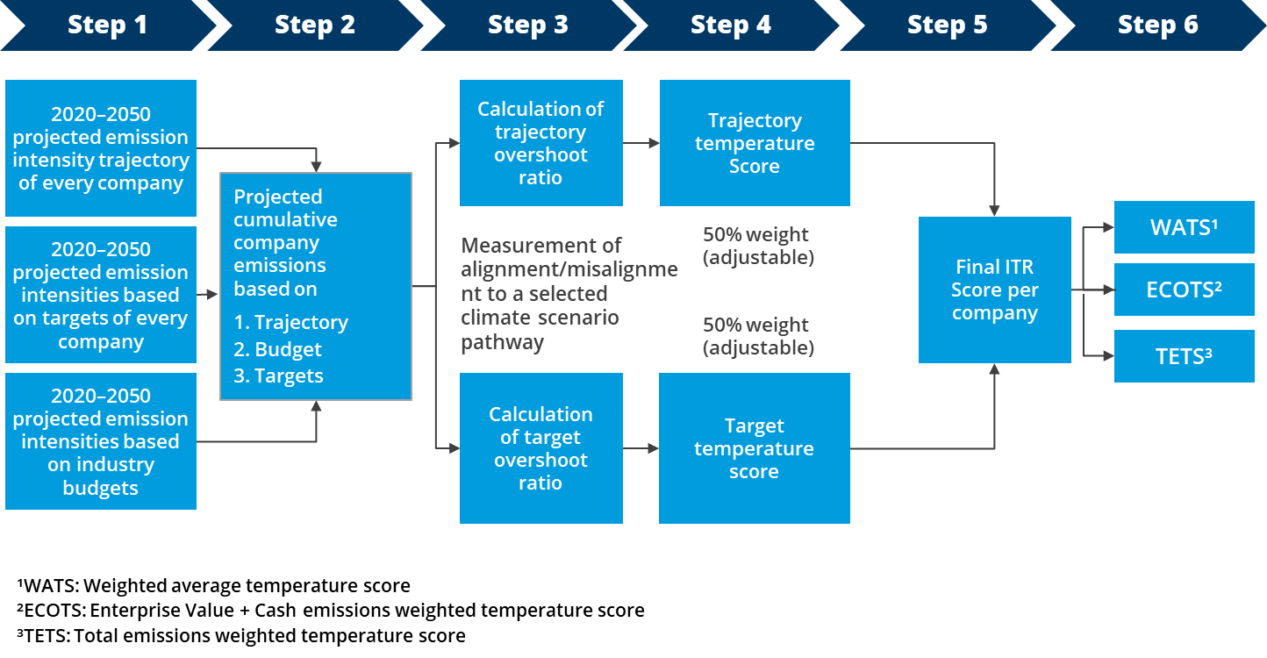
The approach
SAT—calculation process

Slide 8
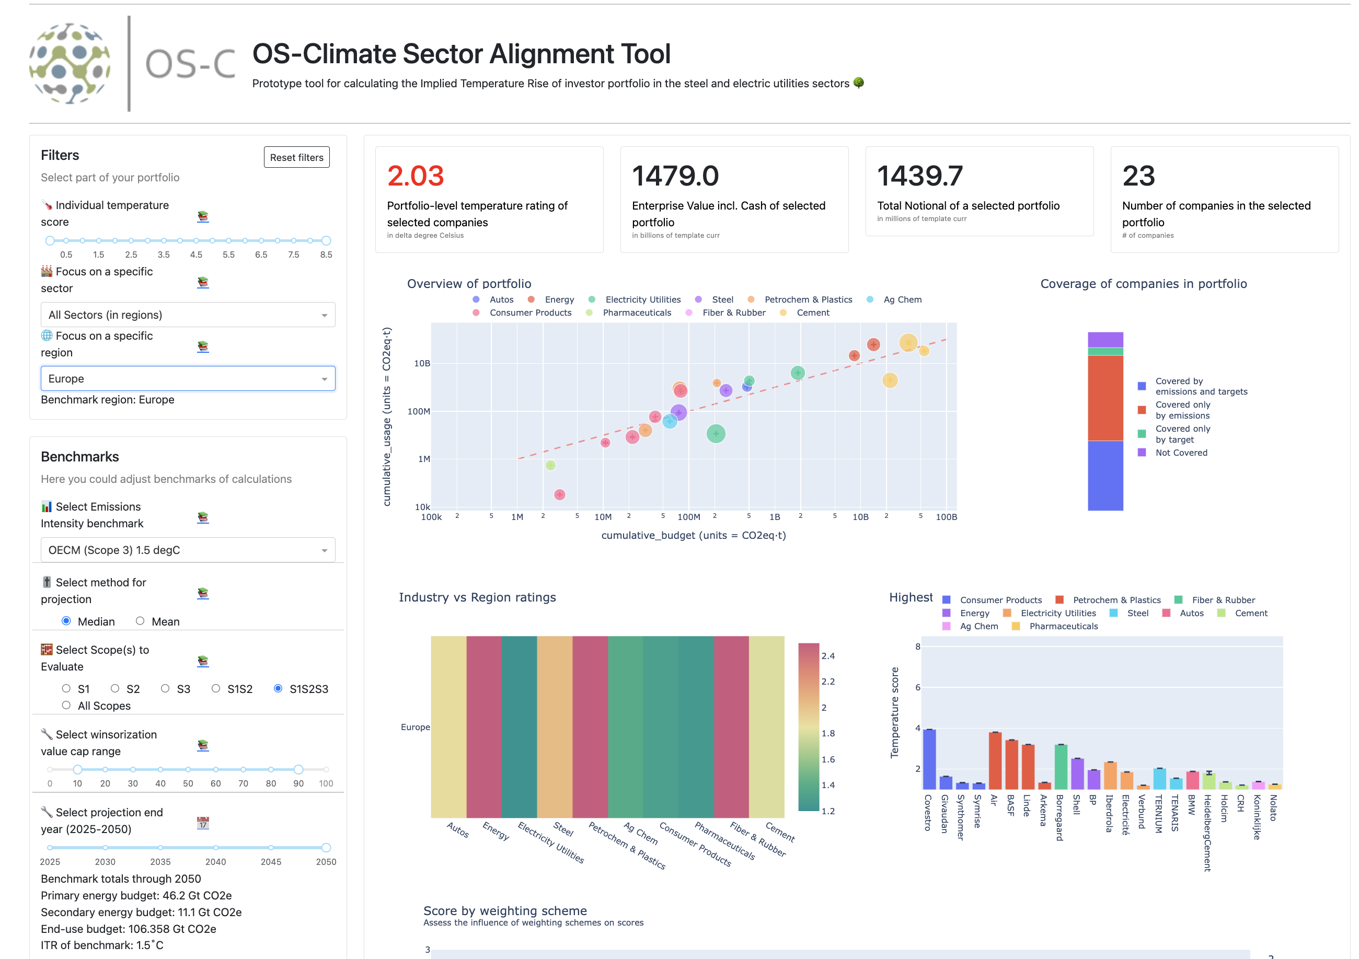






Results
OS-C final SAT scores can be aggregated in six different weighting models
OS-C will allow for tailored analytics for selected corporates across
Sectors (defined in benchmarks)
Regions (defined by user data, mapped to benchmarks)
Scopes (S1, S1+S2, S1+S2+S3, etc.)
Time horizon 2025-2050
Aggregation types (e.g. weighted average, enterprise value weighted etc.)
Scenarios (e.g. OECM, TPI)
SAT model that generates portfolio level scores across different climate scenarios, sectors and regions

Slide 9
Scope 3
Challenges around Scope 3 integration
400 GtCO2
2020-2050
The OECM defines the three emissions scopes as follows:
Scope 1—All direct emissions from the activities of an organisation or under their control, including fuel combustion on site (such as gas boilers), fleet vehicles, and air-conditioning leaks.
Scope 2—Indirect emissions from electricity purchased and used by the organisation. Emissions are created during the production of energy and are eventually used by the organisation.
Scope 3—GHG emissions caused by the analysed industry that are limited to sector-specific activities and/or products classified in GICS.
Scope 3 challenges
Real decarbonization requires for cumulative emissions to stay within a defined carbon budget.
Integrating all carbon emission scopes of a company without a clear understanding of the set-up and underlying assumptions of a climate benchmark, generates meaningless results.
Estimations and uncertainty factors play an important role in determining sector alignment.
To meet 1.5°C with 67% likelihood
Broken down to 12 major GICS sectors
Only sector-specific emissions are included.
Treatment of Scope 3 double-counting
Data Inconsistencies
Traveling, commuting, and all other transport-related emissions are reported under ‘transport’. The lease of buildings is reported under ‘buildings’. All other financial activities, such as ‘capital goods’, are excluded because no data are available for the GICS industry sectors and would lead to double counting.
Separates the sectors into one of three classes: Primary Energy (Oil, Gas, and Coal), Secondary Energy (Power, Heat, and Transport Fuels) and End-use Activities (everything else), and then using only these Scope 3 emissions that balance against a corresponding emission in another class. Each class represents a complete and consistent 3-scope interpretation of the global carbon budget.
Challenges to present the 'OECM Scope 3' emissions as part of the 'OECM Scope 1’ creates inconsistency with the way data is actually reported.
The SAT tool follows the OECM guidance of using ’Production-Centric’ scope definitions for Power Utilities. The SAT tool does not yet provide support for Aviation and Shipping sectors.
Scopes 1,2,3
CO2 + CH4 only

Slide 10
SAT Tool – Input Data Template

Slide 11
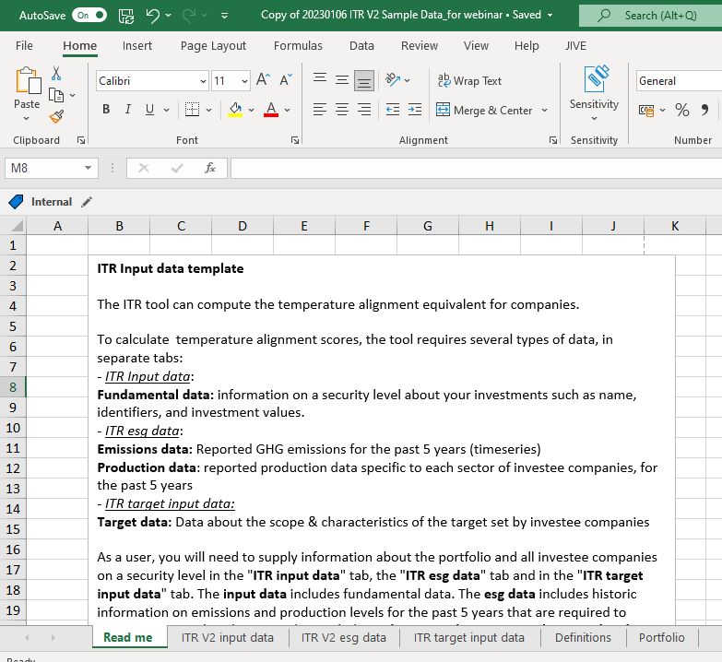
SAT Input Data Template
Template needs to be filled with (well-formatted) data
Two sheets dedicated to documentation: Read me, Definitions
Four sheets to be filled with data by users: ITR input data, ITR ESG data, ITR target input data, Portfolio
Definitions sheet and Data Template Requirements section on GitHub provide detailed information on how to fill the template
Provides a common ground for harmonizing complex/disparate corporate disclosures that can be examined, critiqued, and updated by analysts, not only data providers

Slide 12
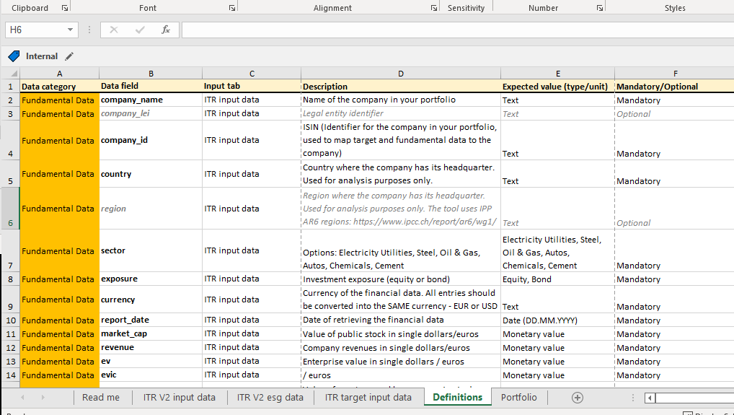
Definitions Sheet

Slide 13

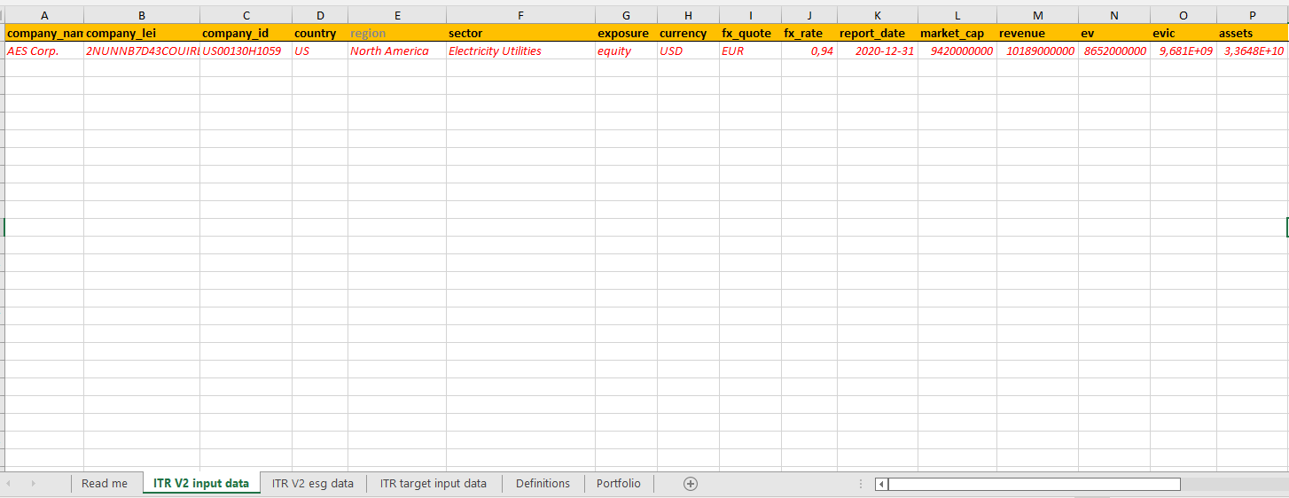
SAT Input Data Sheet– Fundamental Data
Information on Fundamental company data like name, id, country, sector, and financial data
Tool currently analyses several high emitting sectors: Electricity Utilities, Steel, Autos, Oil & Gas, Chemicals, Cement
Currency values can be entered in common or native currencies

Slide 14

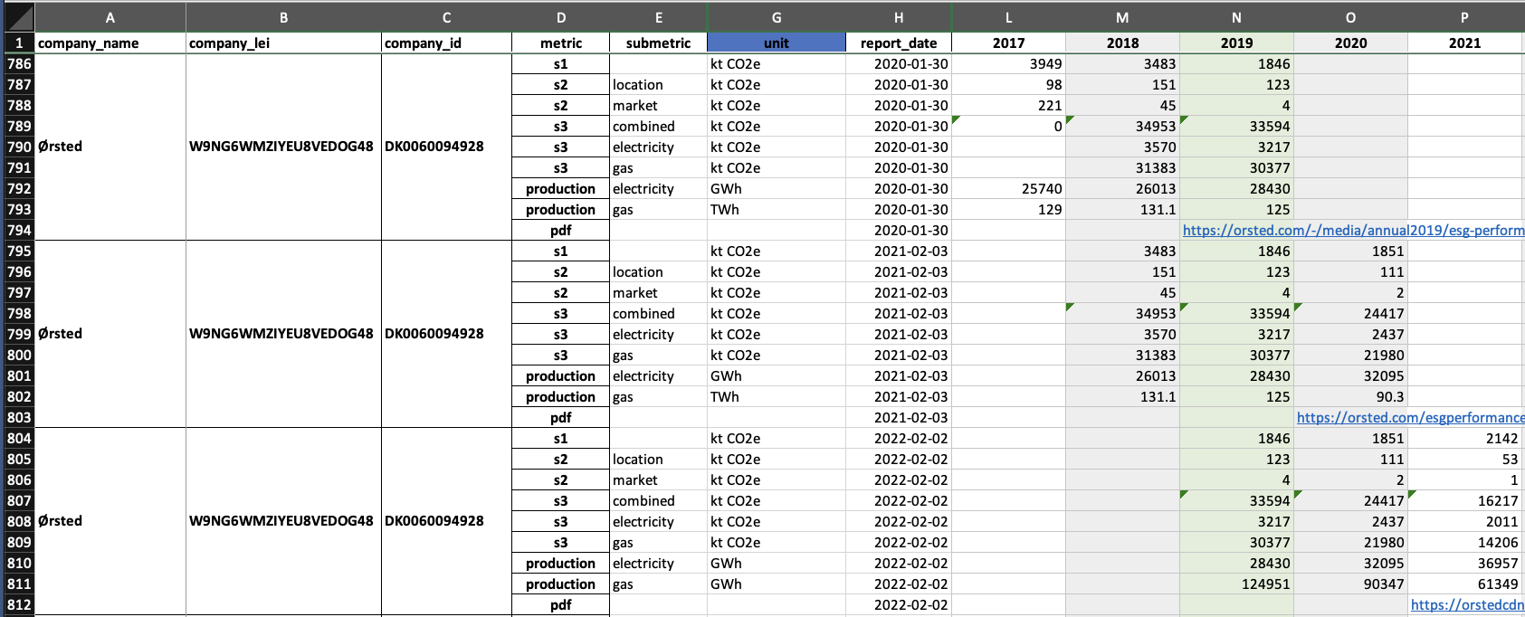
SAT Input Data Sheet – Emission and Production Data
Information on historic emission and production data over the last 5 years
Emission data can be provided separately for the scopes (1, 2 ,3) or combined
Production metric depends on the sector, e.g. MWh for Electricity Utilities, Fe_ton for Steel
Tool accepts any imperial or metric units for the emission and production metric

Slide 15

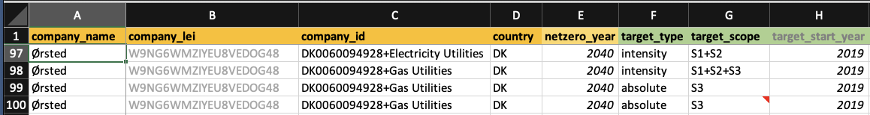
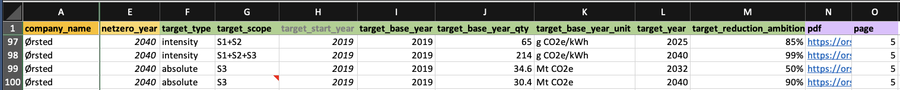
SAT Target Input Data Sheet
Information on net zero-year, target type, scope, start year, base year, base year unit & quantity, reduction ambition
Same identifiers (company name, LEI, id) used as in ITR input data sheet
One row of target data per target of a company (absolute or intensity)
Companies spanning multiple sectors can be split apart by sectors
Sectoral components specify sector-specific target data (type, scope, year, qty, etc)

Slide 16

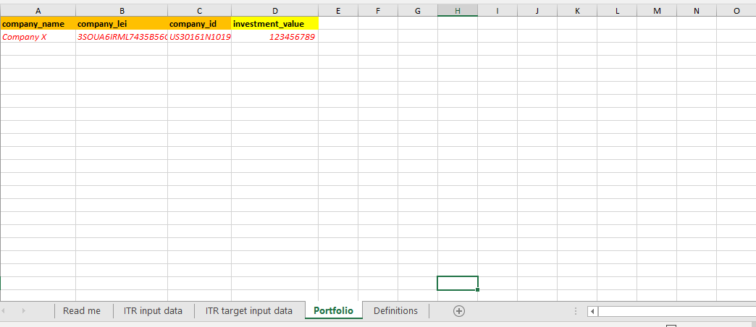
Portfolio Data
Information on the companies in your portfolio with the respective investment value
One row per company in your portfolio

Slide 17
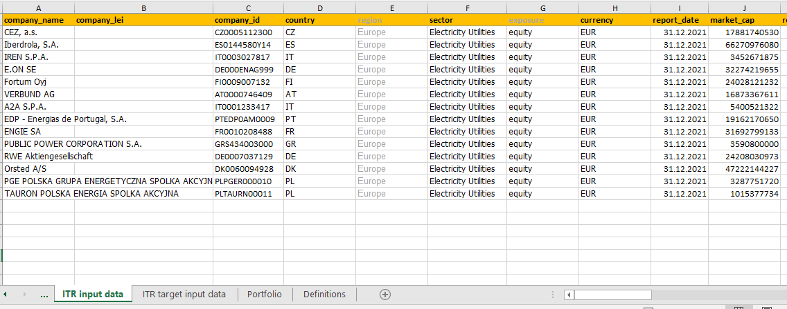
Example

Slide 18
SAT Tool – Live Demo

Slide 19
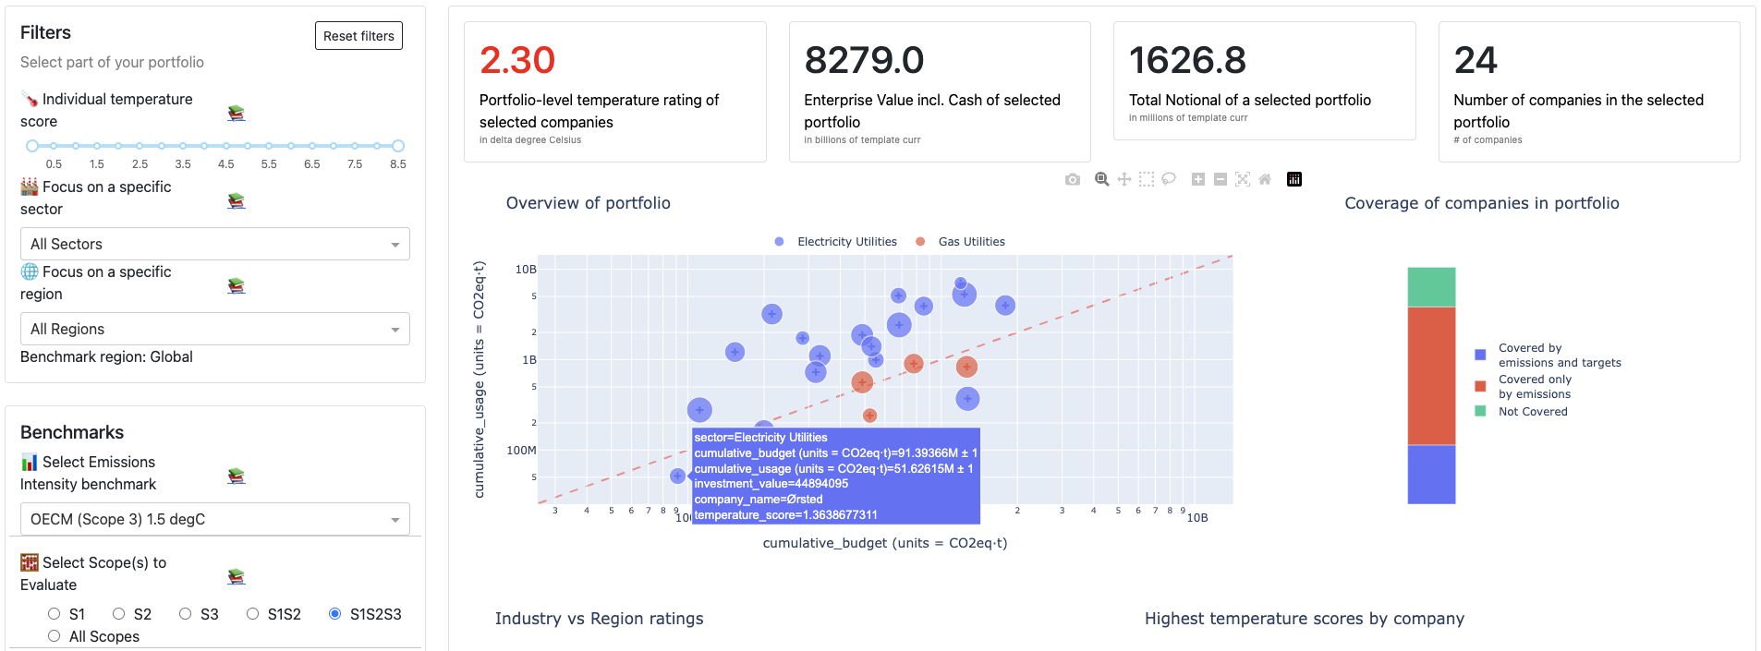
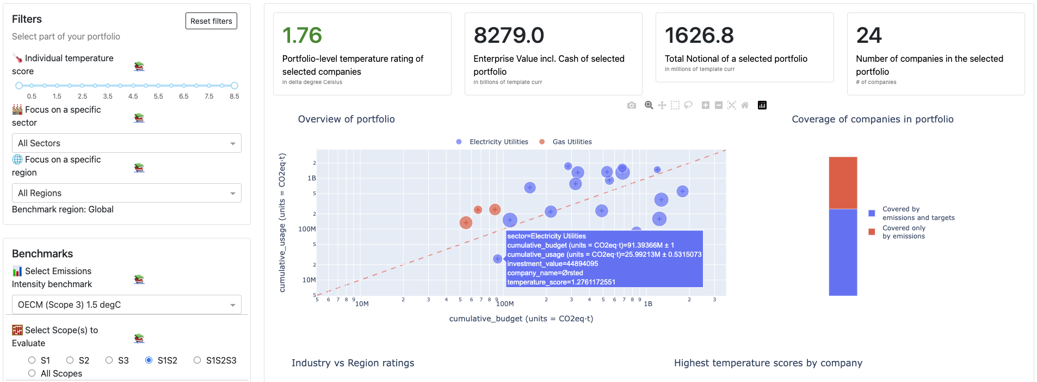
Results
Scope-based Alignment
S1+S2+S3
S1+S2

Slide 20
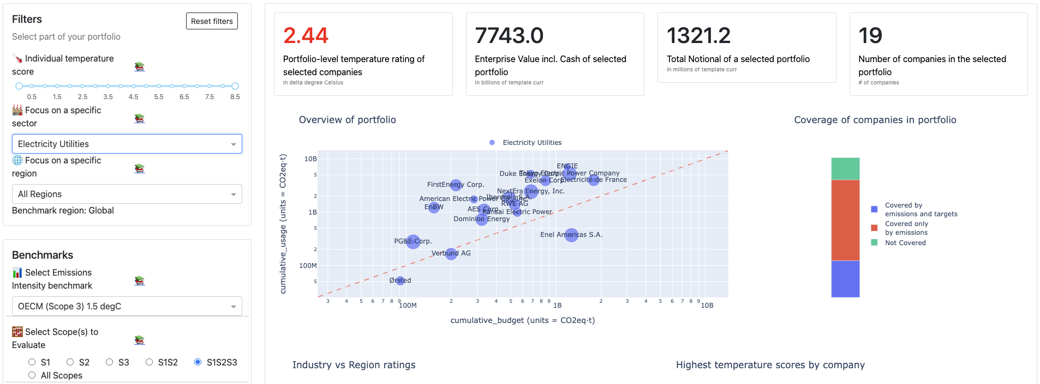
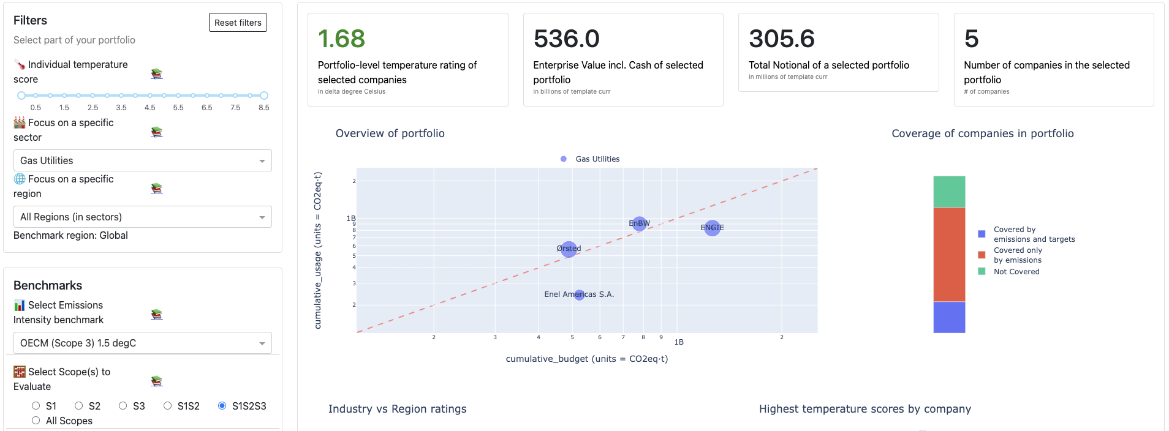
Results
Sector-based Alignment
Electricity Utilities
Gas Utilities

Slide 21
Feedback

Slide 22
We need your feedback:
What are the main use cases for you to apply a sector alignment tool?
Should the tool integrate combined scope 1 + 2 + 3 Emissions or separate these?
How comfortable are you with Scope 3 integration given lack of guidance and data quality around this topic?
What sectors are a priority for you?
Would you find it helpful to generate region and country specific temperature alignment results?
Are there any other data points you would like SAT tool to incorporate?
Would you recommend any changes to users controls and/or output visualizations?
What else would you like to see in an SAT tool?
Biogenic vs. Non-biogenic emissions
Benchmark-aligned missing data estimations (with uncertainties)
Data connectors (bypassing data template)
Alternate trajectory projections
Green financing effects / opportunities
Carbon markets/offsets
Metrics other than temperature score (such as carbon budget exceedance year)

Slide 23

We Welcome Your Participation
“The best way to predict the future is to create it”
If you are not satisfied with the commercial or proprietary tools available to you for setting your targets and implementing your Net Zero commitments, join the OS-Climate Sector Alignment Tool Project, contributing some time from your:
• Software developers.
• Data Engineers.
• SMEs, including sector specialists.

Slide 24
Thank You!

